Slide 1
Data Structure and Algorithm Binary Tree

Slide 2
Discussed So far
Here are some of the data structures
we have studied so far:
Arrays
Stacks, Queues and deques
Linked list
Inherently uni-dimensional in structure

Slide 3
Motivation
Key difference between sorted list and unsorted list.
 | Unsorted List | Sorted List
RetrieveItem | O(N) | O(logN)
InsertItem | O(1) | O(N)

Slide 4
Motivation
Key difference between sorted list and unsorted list.
 | Unsorted List | Sorted List
RetrieveItem | O(N) | O(logN)
InsertItem | O(1) | O(N)
Can we improve this operation?

Slide 5

Tree Data Structure

Slide 6
Tree Data Structure
leaves
Branches
root

Slide 7
Tree
A node in the definition of the tree represents an item of information, and the links between the nodes termed as Branches represent an association between the items of information.

Slide 8
Tree Data Structure
Tree
Collection of nodes linked to each other (similar to linked lists)
Each node can have 0 or more children (successor nodes)
Each node (except the root) has exactly one parent (predecessor node)
This means that there is exactly one path to go from the root to any other node
Tree
Not Tree

Slide 9
Tree Data Structure
Terminology
Root ⇒ node with no parent
Leaf ⇒ node(s) with no child
Interior ⇒ non-leaf nodes
Root node
Interior nodes
Leaf nodes

Slide 10
Tree Terminology
A tree consists of a collection of elements or nodes, with each node linked to its successors
The links from a node to its successors are called branches
The successors of a node are called its children

Slide 11
Tree Terminology (continued)
Node: stores the actual data and links
to other nodes
Parent: immediate predecessor of a node
Root: specially designated node which
has no parent
Child:immediate successor of a node.

Slide 12
Tree Data Structure
Terminology
Level ⇒ number of ancestors (parent or parent’s parent or …) up to the root (distance from the root)
Height ⇒ number of levels
Some books use height = highest level in the tree
Level 0
Height = 3
Level 1
Level 2

Slide 13
Tree Terminology (continued)
Each node in a tree has exactly one parent except for the root node, which has no parent
Nodes that have the same parent are siblings
A node that has no children is called a leaf node
A generalization of the parent-child relationship is the ancestor-descendent relationship

Slide 14
Tree Terminology (continued)
The predecessor of a node is called its
Parent
A subtree of a node is a tree whose
root is a child of that node
The level of a node is a measure of its distance from the root
10

Slide 15
Tree Terminology (continued)
Degree of the Node: Maximum number of the children possible for a node.
Siblings: Nodes having the same parent
Ancestor of a Node: Those nodes that occur on the path from the root to the given node
Degree of a Tree: Maximum degree of
the node in the tree
Forest : A set of Zero or more Disjoint trees.

Slide 16
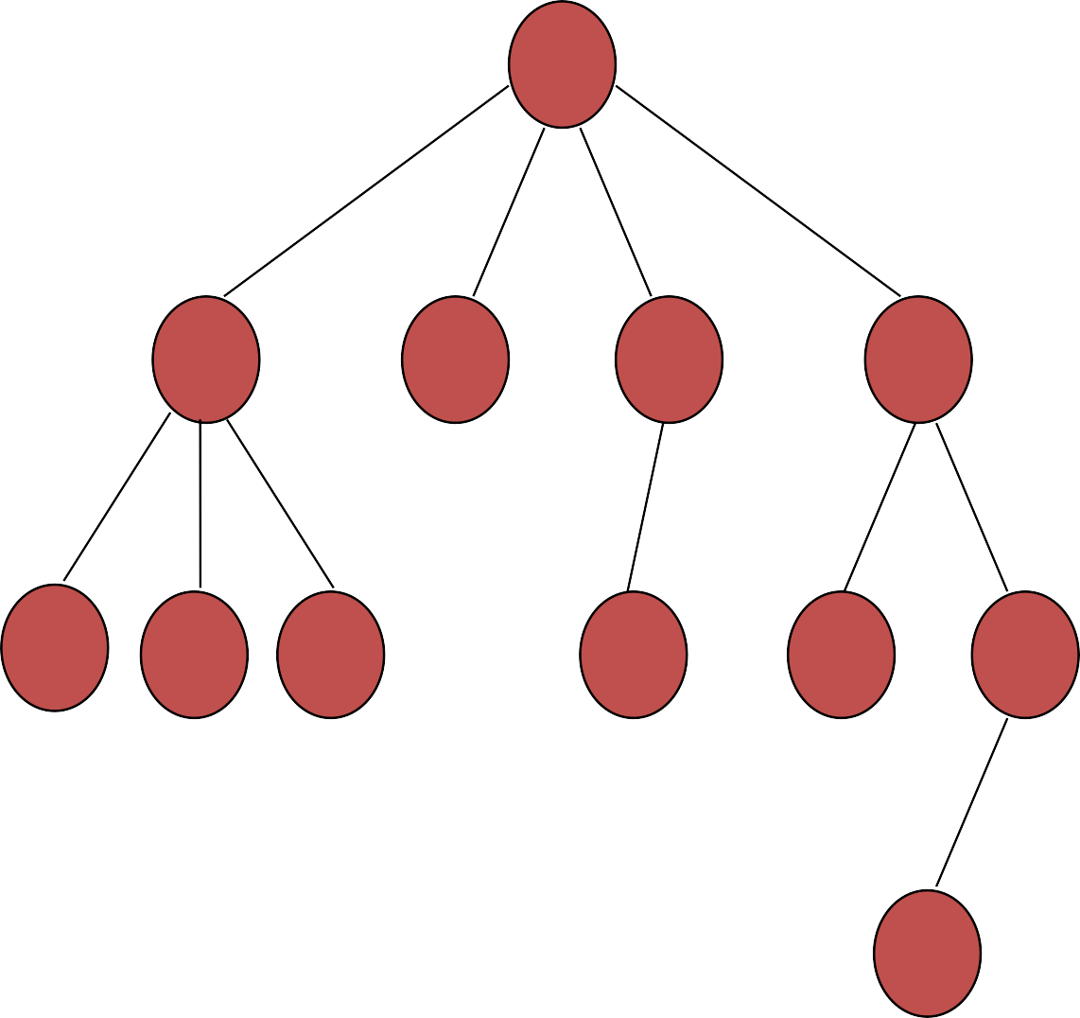
Degree of the tree = 4 (Max degree of A)
A
Level 1
B
C
D
E
Level 2
F
G H
I
J
K
Level 3
Height of the tree = 4
(Max level)
L
Level 4

Slide 17
Representation of a tree
List Representation
(A (B(F,G,H), C, D(I), E(J,K(L))) )
For the tree Considered in the Example
Linked List Representation

Slide 18
DATA | LINK 1 | LINK 2 | … | LINK n
(a) General node structure
T
A
B
C
D
E
F
G
H
I
J
K
L
(b) Linked list representation of the tree

Slide 19
Binary Tree
Full tree
A binary tree is full if each node is either a leaf or possesses exactly two child nodes.
Complete tree
A binary tree is complete if all levels (except possibly the last) are completely full, and the last level has all its nodes to the left side.

Slide 20
Binary Tree
Full tree
A binary tree is full if each node is either a leaf or possesses exactly two child nodes.
Complete tree
A binary tree is complete if all levels (except possibly the last) are completely full, and the last level has all its nodes to the left side.

Slide 21
Binary Tree
Full tree
A binary tree is full if each node is either a leaf or possesses exactly two child nodes.
Complete tree
A binary tree is complete if all levels (except possibly the last) are completely full, and the last level has all its nodes to the left side.
Neither full nor complete

Slide 22
Binary Tree
Full tree
A binary tree is full if each node is either a leaf or possesses exactly two child nodes.
Complete tree
A binary tree is complete if all levels (except possibly the last) are completely full, and the last level has all its nodes to the left side.

Slide 23
Binary Tree
Full tree
A binary tree is full if each node is either a leaf or possesses exactly two child nodes.
Complete tree
A binary tree is complete if all levels (except possibly the last) are completely full, and the last level has all its nodes to the left side.
Full but not complete

Slide 24
Binary Tree
Full tree
A binary tree is full if each node is either a leaf or possesses exactly two child nodes.
Complete tree
A binary tree is complete if all levels (except possibly the last) are completely full, and the last level has all its nodes to the left side.

Slide 25
Binary Tree
Full tree
A binary tree is full if each node is either a leaf or possesses exactly two child nodes.
Complete tree
A binary tree is complete if all levels (except possibly the last) are completely full, and the last level has all its nodes to the left side.
Not full but complete

Slide 26
Binary Tree
Full tree
A binary tree is full if each node is either a leaf or possesses exactly two child nodes.
Complete tree
A binary tree is complete if all levels (except possibly the last) are completely full, and the last level has all its nodes to the left side.

Slide 27
Binary Tree
Full tree
A binary tree is full if each node is either a leaf or possesses exactly two child nodes.
Complete tree
A binary tree is complete if all levels (except possibly the last) are completely full, and the last level has all its nodes to the left side.
Full and complete

Slide 28
A binary tree which is dominated solely by left child nodes or right child nodes is called a skewed binary tree or more specifically left skewed binary tree or right skewed binary tree respectively.
a
m
b
n
o
c
Left skewed
Right skewed
p
d

Slide 29
Extended Binary Tree: 2-Tree
A binary tree T is said to be 2-Tree or an extended binary tree if each node N has either 0 or 2 children.
Nodes with 2 children are called internal nodes and the nodes with 0 children are called external nodes.

Slide 30




Binary Tree
How many nodes can there be in one level of a binary tree?
Maximum number of nodes in level $i$ = $2^{i}, i=0, 1, 2…$
Level 0
$$≤2^{0}$$
Level 1
$$≤2^{1}$$
Level 2
$$≤2^{2}$$

Slide 31
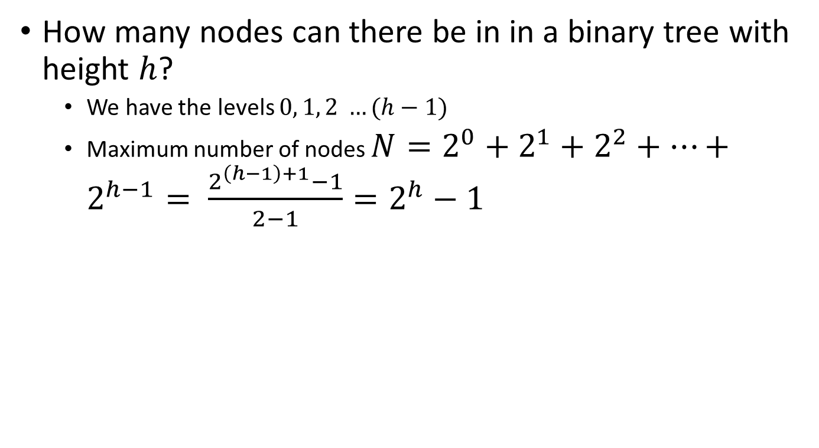
Binary Tree
How many nodes can there be in in a binary tree with height $h$?
We have the levels $0, 1, 2 …(h−1)$
Maximum number of nodes $N=2^{0}+2^{1}+2^{2}+…+2^{h−1}= \frac{2^{\left(h−1\right)+1}−1}{2−1}=2^{h}−1$
Level 0
$$≤2^{0}$$
Level 1
$$≤2^{1}$$
Level 2
$$≤2^{2}$$

Slide 32

Binary Tree
What is the height of a binary tree with $N$ nodes?
We have seen that $N=2^{h}−1$
So, $h=\log_{2}{(N+1)}$
Minimum height is $\log_{2}{(N+1)}$ or simply $\log{N}$
Maximum height is $N$
Level 0
$$≤2^{0}$$
Level 1
$$≤2^{1}$$
Level 2
$$≤2^{2}$$

Slide 33

Binary Tree
What is the height of a binary tree with $N$ nodes?
For example, if we have 10 nodes
Minimum height = $\log{10=3.31\sim 4}$
Maximum height = $10$

Slide 34

Binary Tree
What is the height of a binary tree with $N$ nodes?
For example, if we have 10 nodes
Minimum height = $\log{10=3.31\sim 4}$
Maximum height = $10$

Slide 35
Binary Tree
What is the height of a binary tree with $N$ nodes?
For example, if we have 10 nodes
Minimum height = $\log{10=3.31\sim 4}$
Maximum height = $10$
When tree is complete (best case)

Slide 36

Binary Tree
What is the height of a binary tree with $N$ nodes?
For example, if we have 10 nodes
Minimum height = $\log{10=3.31\sim 4}$
Maximum height = $10$

Slide 37
Binary Tree
What is the height of a binary tree with $N$ nodes?
For example, if we have 10 nodes
Minimum height = $\log{10=3.31\sim 4}$
Maximum height = $10$
When each node has one child (worst case)

Slide 38
Representation of Binary Tree
Binary tree can be represented by means of
[a] Array
[b] linked list
30

Slide 39
Representation Of Binary Trees
Array Representation
1
Sequential representation of a tree with depth d will require an array with approx 2^{d + 1}
a
2
b
4
c
10
5
d
e
f
11
1 2 3 4 5 6 7 8 9 10 11
a | b |  | c | d |  |  |  |  | e | f

Slide 40
Linked representation
T
a
b
LCHILD | DATA | RCHILD
c
d
e
f

Slide 41
Observation regarding the linked representation of Binary Tree
[a] If a binary tree has n nodes then the number of pointers used in its linked representation is 2*n
[b] The number of null pointers used in the linked representation of a binary tree with n nodes is n+1

Slide 42
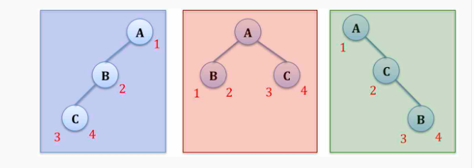
You may try with any number of nodes in the tree, there will always be n+1 NULL pointers in a Binary tree with n Nodes.

Slide 43
Binary Search Trees
Key property
Value at any node
Larger than the value of left child
Which means that it is larger than all values in left subtree
Smaller or equal to the value of right child
Which means that it is smaller than all values in right subtree
10
2
12

Slide 44
Binary Search Trees
Examples
5
10
10
2
45
5
30
5
45
30
2
25
45
2
25
30
10
25

Slide 45
Binary Search Trees
Examples
5
10
10
2
45
5
30
5
45
30
2
25
45
2
25
30
10
25
Binary search trees
Not a binary search tree

